Slide 1
A&G Analytics- Candidate Exercise
Maryam Heidari

Slide 2


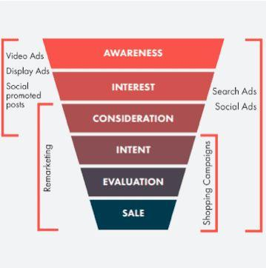
Exercise 1: Data Analysis
Client: Bank
Goal: new applicants for checking accounts
We are in the last stage of Marketing: Sale

Slide 3
what 2 KPIs would you recommend as their focus for the campaign?
How would you calculate those and incorporate those into your analysis?
Conversion Rate :
Conversion rate = (conversions/total click) * 100%
Why? Because of our goal (increase new account opens)
Placement :
what Ads and content is more suitable to our potential client?
where we are most likely to find our potential client? (which vendor)

Slide 4
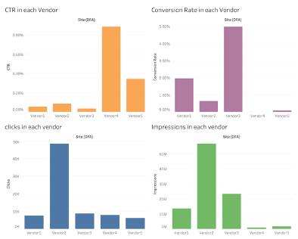
What would you recommend for future creative development to improve performance?
What sizes are helping to generate the most value based on your selected KPIs?
Vendor 3 has the most Conversion Rate
Vendor 4 has the best CTR, but the Conversion Rate is zero
Vendor 2 has the highest Impression and Click

Slide 5
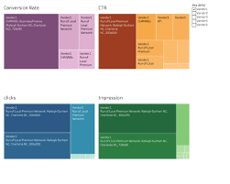
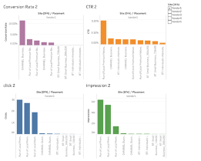
Vendor 1
Low CTR
Reasonable Conversion Rate
So, there is a potential in this vendor that we need to find and unlock them
Recommendation:
Change the content especially for “Run of Local Premium Network: Raleigh-Durham NC, Charlotte NC_300x600” and “Run of Local Premium Network: Raleigh-Durham NC, Charlotte NC_300x250”

Slide 6
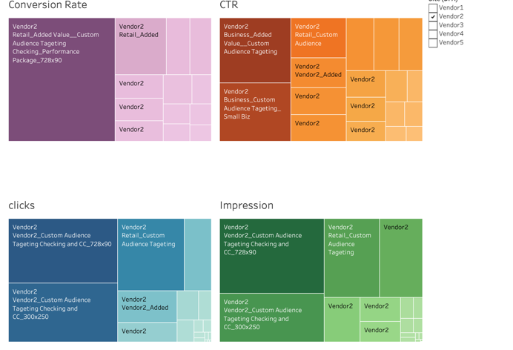
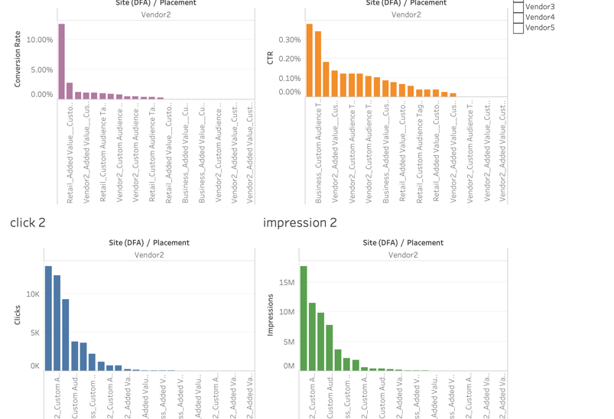
Vendor 2
highest number of impressions and click
Lowest CTR
Conversion Rate is 0.5%
This vendor is popular and has a lot of viewer, but because of the low CTR and Conversion Rate, I do not believe it is best place to find our potential client
Recommendation:
Do some research about the vendor 2 content and its users and analyze if there is any relation between these 2 factor and our services. If there is no relation, we need to drop this vendor

Slide 7
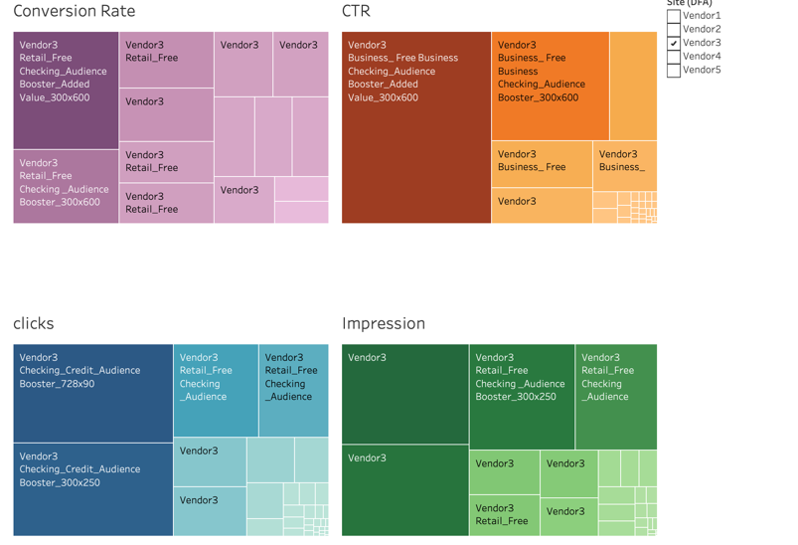
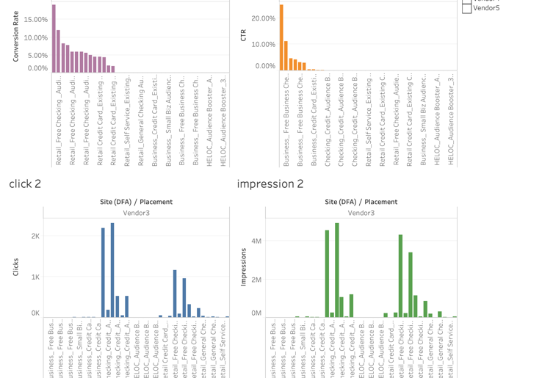
Vendor 3
Highest Conversion Rate
Low CTR
If we improve the CTR, we can reach to a good amount of potential customer
Recommendation:
We need to invest more in this vendor. T
the best placements
1)“Retail_Free Checking_Audience Booster_Added Value_300x600“
2)“Retail_Free Checking _Audience Booster_300x600”
3) “Retail_Free Checking _Audience Booster_728x90”
4) “Checking_Credit_Audience Booster_Added Value_300x600”
We need to find the key word and content are these and add them to other Ads

Slide 8
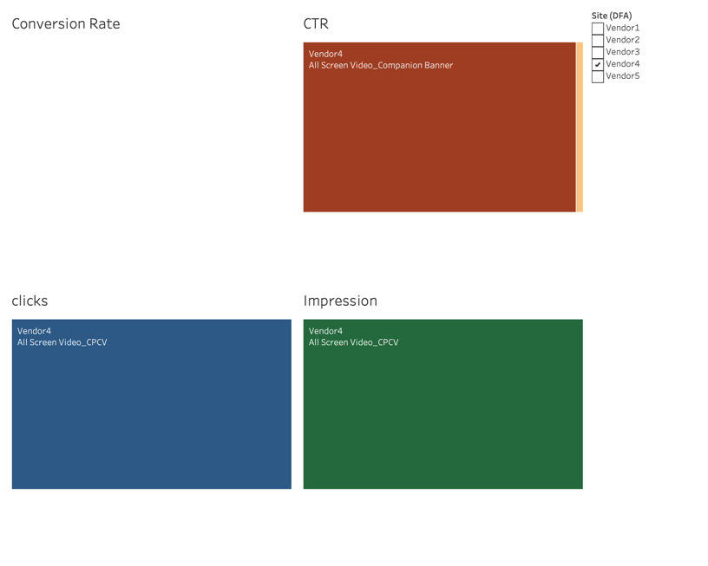
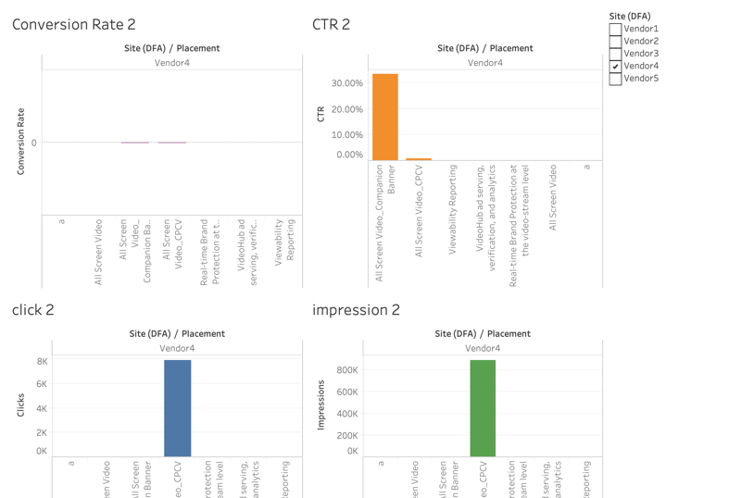
Vendor 4
Highest CTR
Zero Conversion Rate
I believe our potential customer are not in this vendor
Recommendation:
Study why this vendor has the highest CTR, what is the method we advertise there? What is the relation between Ads and website content?
Learn and apply them on other vendors.
We also need to looking for misrepresentation in our Ads in this vendor

Slide 9
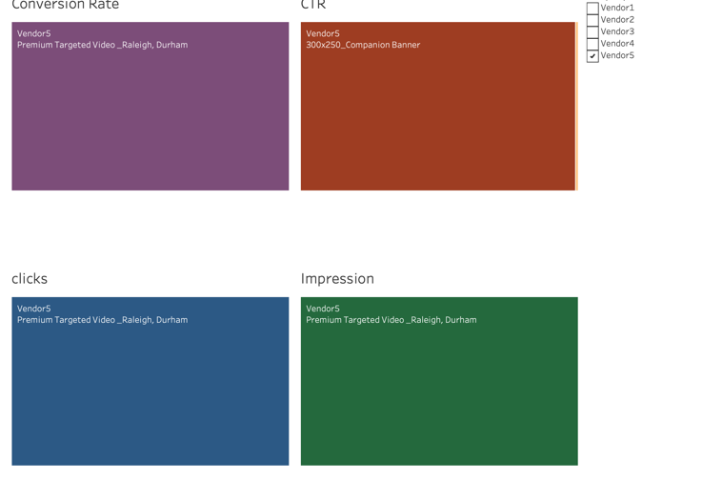
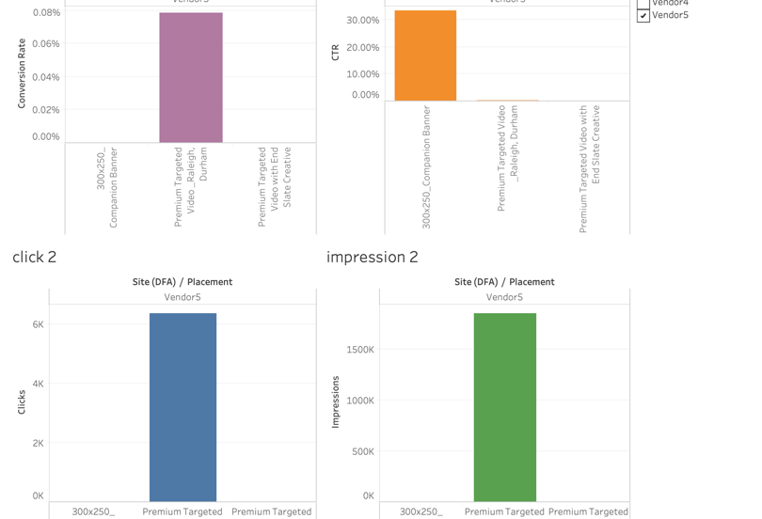
Vendor 5
High CTR
Low Conversion Rate
We need to look for a same problem that we have with vendor 4. we need to look for misrepresentation
Recommendation:
Same as vendor 4

Slide 10
How would you reallocate the bank’s media spend, based on the available data and your selected KPIs?
We need to change our strategy in spending money.
the highest Media Cost belongs to vendor 2, but it has a lowest CTR and near 0.5% conversion Rate.
Invest more on Vendor 3
We almost spend nothing on vendor 4 but we get a high CTR, we need to analyze that

Slide 11
Top 10 Conversion Rate
As you can see, we dedicate a little amount of money to the top 10 Conversion Rate. We need to invest more in these placement because they lead us to our goal.

Slide 12
Top 10 Media cost
Most of the top 10 media cost does not lead to high Conversion Rate.
The highest Conversion Rate in here is 6% but the highest Conversion Rate is more than 15%

Slide 14
Q & A

Slide 15
Exercise 2: Case Question
Client: electrical automotive company
Goal: advise for marketing investment strategy
We are in the first stage of Marketing: Awareness and Interest

Slide 16
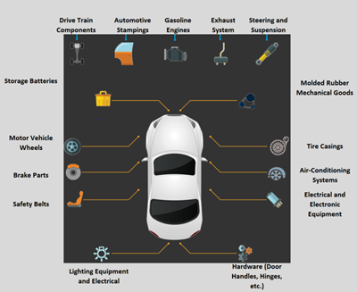
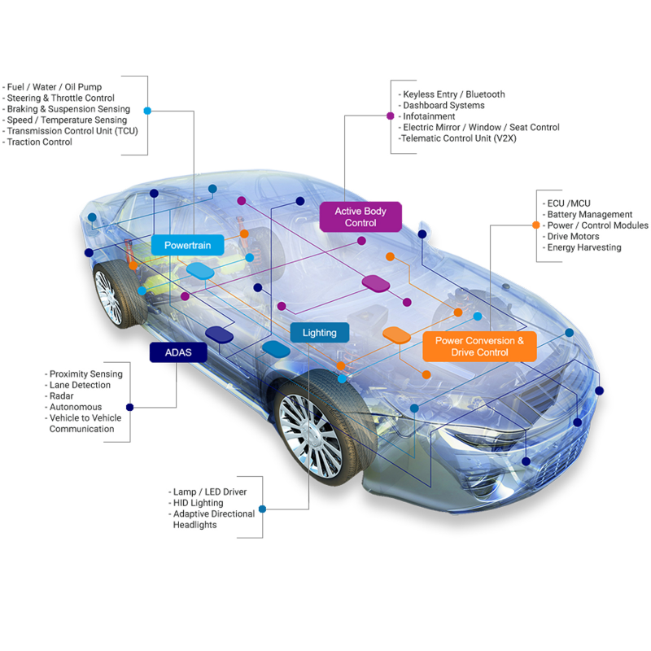
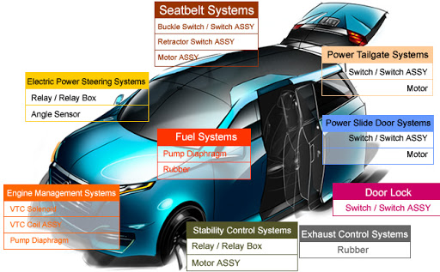
Awareness
which features are more desirable for customers
Advantages over well-known brands
Keyword and content of our Ads

Slide 17
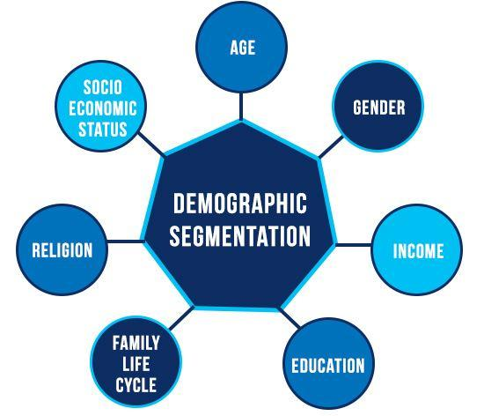
interest
What demographic segmentation? (age, income, education, …)
Where we should do our advertising ( environment friendly people, ...)
Where is our target market?
Where should start to interduce ourselves?
How we are going to approach them?
what method we need to use? What placement?

Slide 18
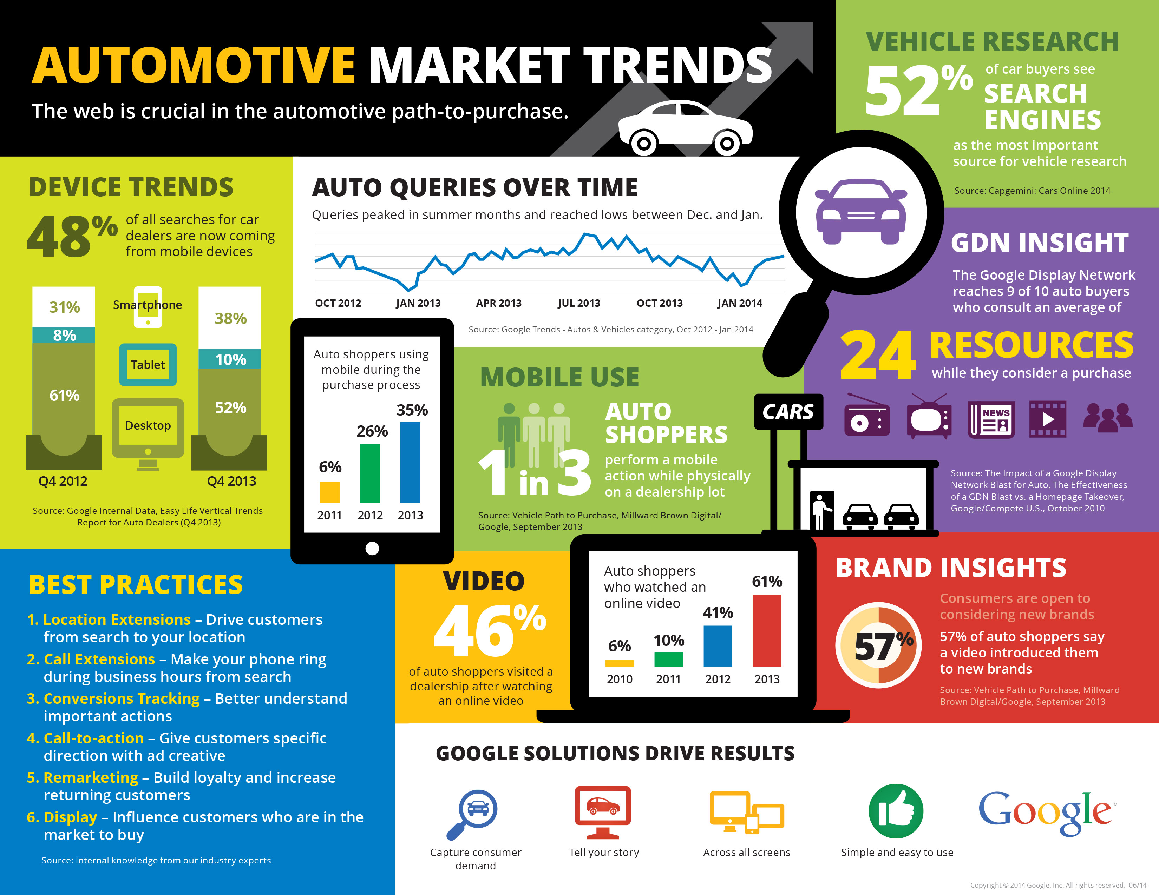
Example of the result

Slide 19
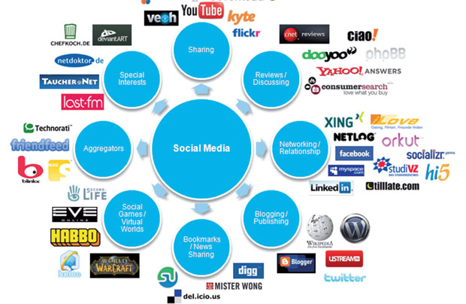
Need to make impression
Social networking is fundamental
Being more visible to individuals
Find tech or over the top platforms for automotive
Good reviews

Slide 20
Sources to collect data
recent articles such as automotive lead production
White Papers
Other Sites
Tech conferences ( because it is electric car)
Videos
CRM systems
Social Channels

Slide 21
Q & A

Slide 22
Thank you so much for your attention

